Slide 1

Server Side Functionalities
19CSE335 Ethical Hacking

Slide 2
Server Side Programming
Perl, ASP, PHP, JSP etc.. Are some of the well known server side technology
Major funcrions
CGI
The Common Gateway Interface (CGI) was defined to allow to process user input and serve dynamic content on the Web. CGI programs can be developed in any script or programming language, but Perl is by far the most common language
Perl
Perl is a "Practical Extraction and Report Language". Perl is a specialized programming language, which has been designed with powerful text-manipulation functions. Perl is an interpreted language and is easy to understand. Perl has been used for programming World Wide Web electronic forms, for its pattern-matching functions aids in system searches and reporting and generally as glue and gateway between systems, databases, and users.
Active Server Pages
Microsoft Active Server Pages (ASP) is a server-side scripting technology that can be used to create dynamic and interactive web applications. An ASP page at its core is simply a text file that has been named using the extension .asp and which contains HTML and scripting that are processed by a web server before being sent to the user's browser.
An ASP file can be created by including a script written in VBScript or JScript in an HTML file. The most common use of ASP is database connection.
The process of execution of an ASP file starts with the Web Server reading the ASP file, line by line, and it executes the
scripts in the file. Finally, the ASP file is returned to the browser as plain HTML ASP.NET is the latest version of
Microsoft's Active Server Pages technology (ASP)

Slide 3
Java Servlets
An alternative to using CGI & ASP is a Java servlet, which is a Java class. Servlets are capable of handling web input, processing that input, and returning the processed input back through the web server, which is the HTML displayed in your browser. Java Servlets need the Java Virtual machine to execute, which is embedded in the web server.
You can think of them as server-side applets. The web server will load and execute them the same way a browser would an applet. Servlets can maintain state, are platform independent, and extremely extensible as they are written in object oriented Java.
Java Server Pages
JSP technology is an extension of the Servlet technology. It makes it easier to combine fixed or static template data with dynamic content.
Java Server Pages (JSP) is a technology that lets you mix regular, static HTML with dynamically-generated HTML. Servlets, make you generate the entire page via your program, even though most of it is always the same. JSP lets you create the two parts separately.

Slide 4
PHP
PHP is an HTML-embedded scripting language. PHP is freely distributed, including the source code. PHP is a scripting language including all the basic features needed to create interactive www-pages. Since PHP is a scripting language, a PHP program might have a bit long response times.

Slide 5
Attacking Session Management
The session management mechanism is a fundamental security component in the majority of web applications. It is what enables the application to uniquely identify a given user across a number of different requests and to handle the data that it accumulates about the state of that user's interaction with the application.
On the other hand, it becomes a prime target for attackers.
Potential consequences of session management attacks
A user can masquerade as another user
Privilege escalation to administrator, owning the entire application
Can be as simple as incrementing the value of a token

Slide 6
The Need for State
Web 1.0
Stateless
Static pages
No custom content
No logging in
Logging In •
Allow user to register and log in
Require a session to maintain the "state" of being authenticated
Otherwise user would have to log in to each page
No Login
Application with no login function still use sessions
Shopping basket

Slide 7
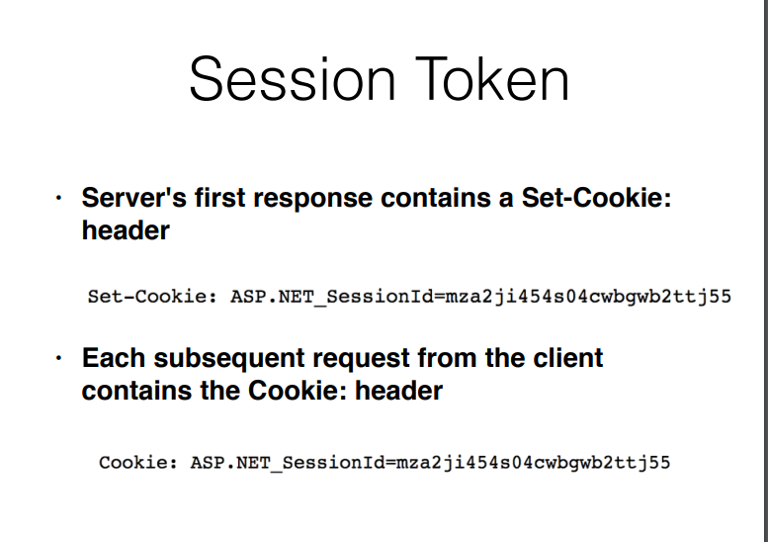

Slide 8
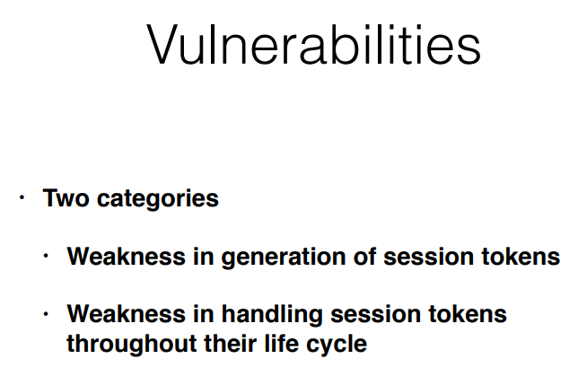

Slide 9
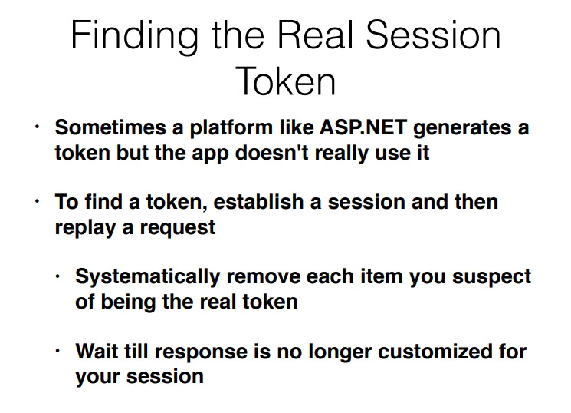

Slide 10
Alternatives to Sessions
HTTP Authentication
Basic, Digest, NTLM
Pass credentials with every request in HTTP headers
Not via application-specific code
Rarely used on Internet-based applications
Sessionless State Mechanisms
Application doesn't issue session tokens or manage the state
Transmit all data required to manage the state via the client in a cookie or hidden form field
Ex: ASP.NET ViewState • Link Ch 7a

